Slide 1
Kelompok 3
Anggota :
Elko Aditya [ A11.2018.10858 ]
Novita [ A11.2018.10851 ]
Rudy Setiawan (A11.2018.11079)
dhodhy darsono (A11.2018.11116)

Slide 2
Cover Page

Slide 3
Project Scope

Slide 4
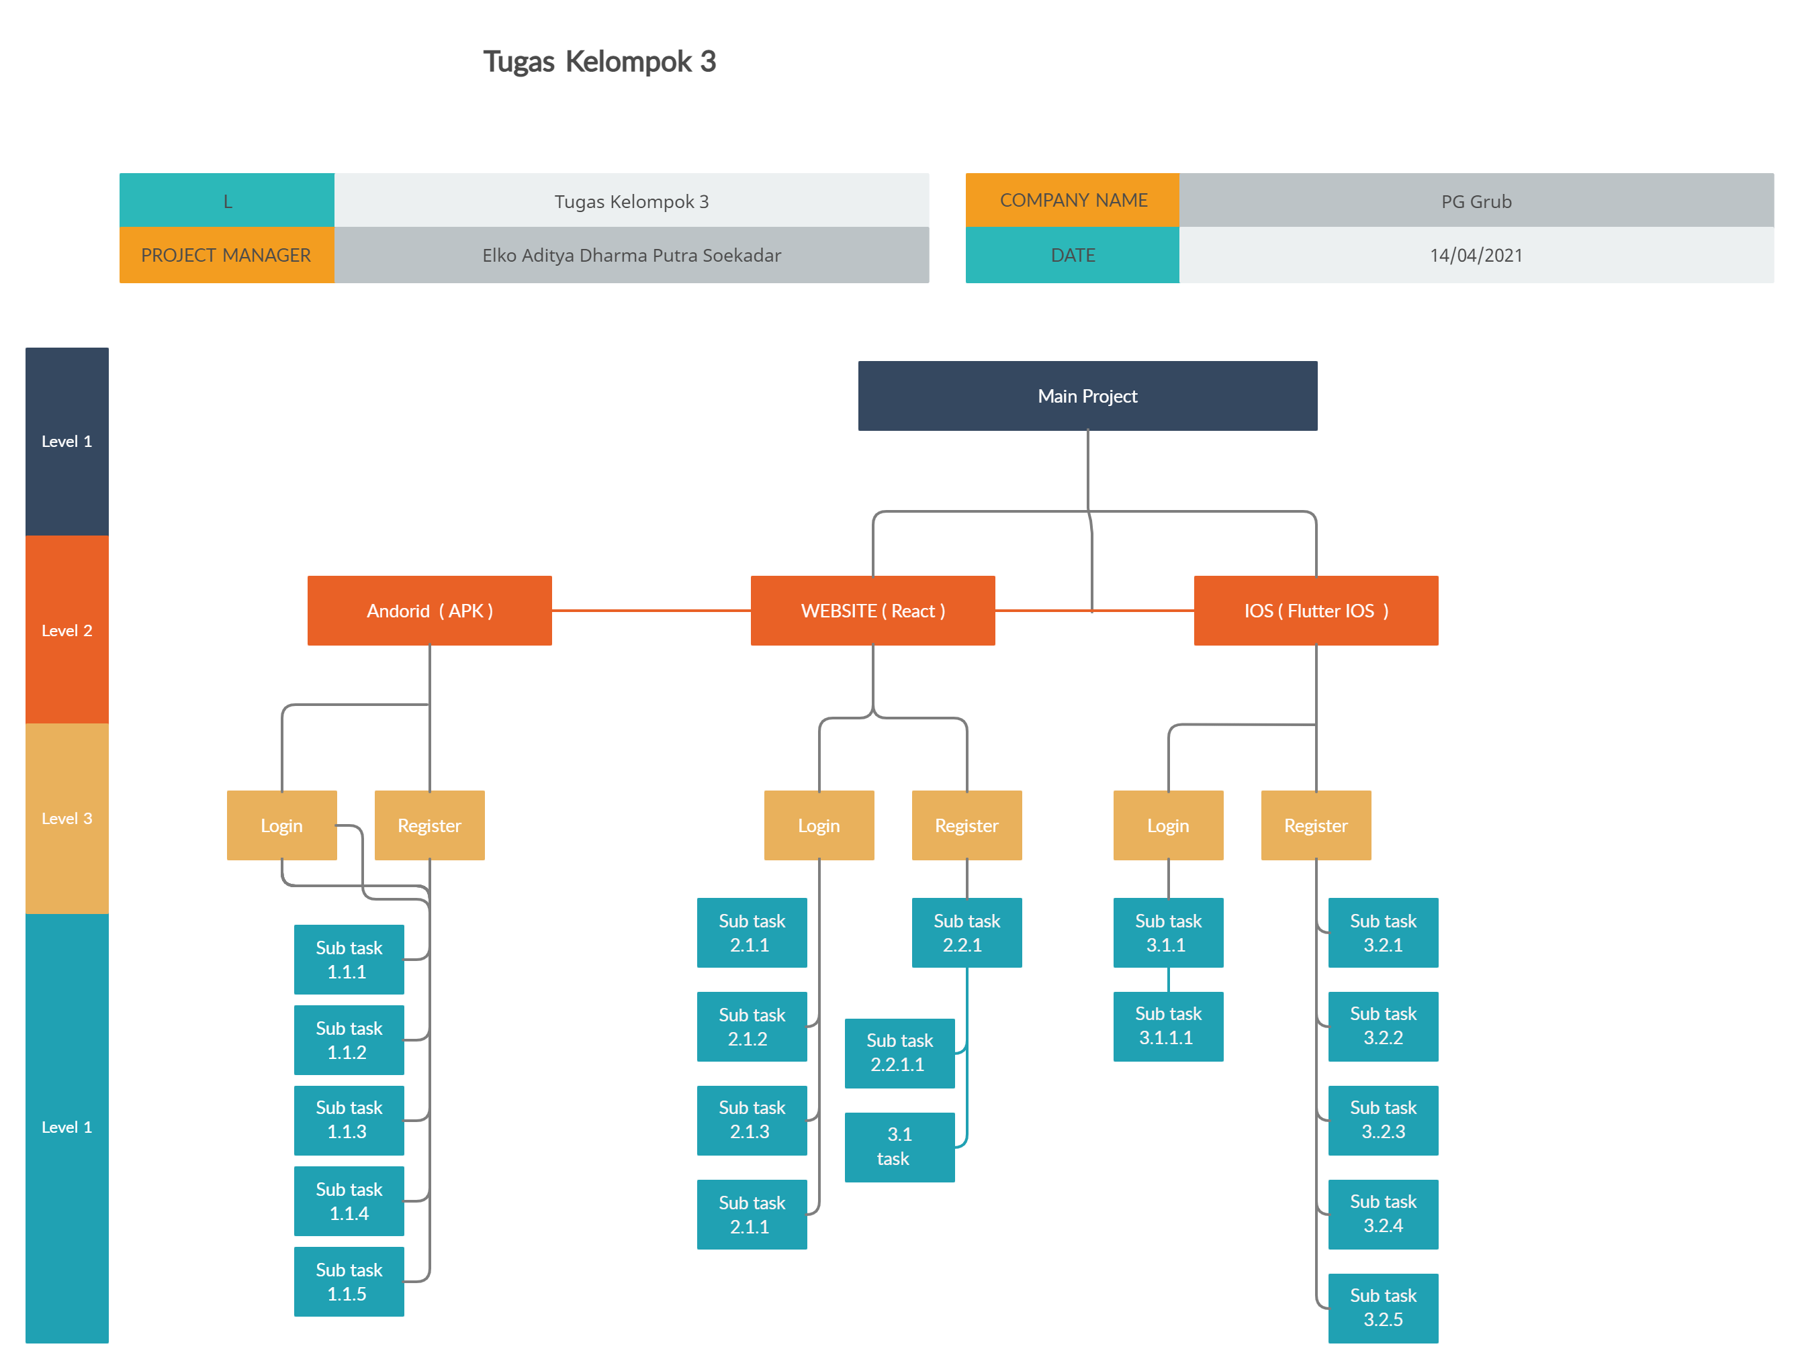
Giant Chart

Slide 5
Project Management

Slide 6
Wirframe

Slide 7
Terima Kasih ☺

